Slide 1
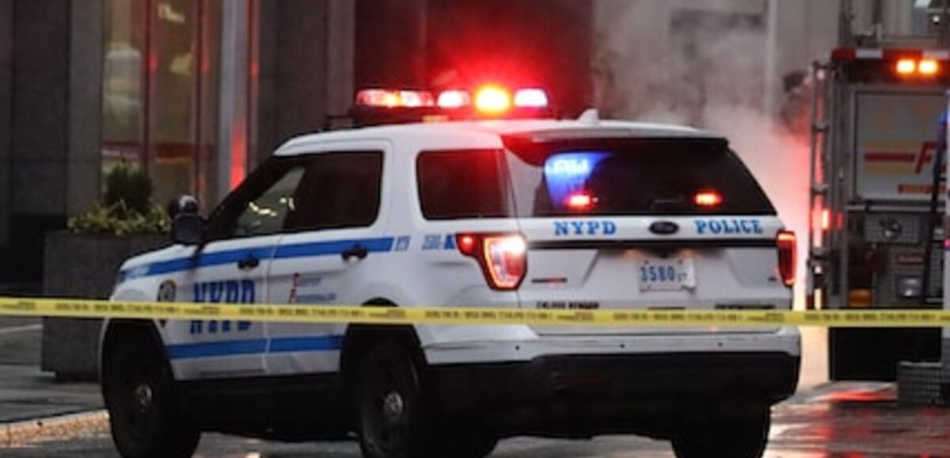

Visualizing and Predicting Crime in Los Angeles
Group F
Rajesh Anne – 11701768
Amrutha Vamshi Goud Anantha – 11674521
Under the guidance of
Denise R. Philpot, PhD, Clinical Associate Professor

Slide 2
AGENDA
Introduction
Motivation and Objectives
Dataset Overview
Data Cleaning & Preprocessing
Exploratory Data Analysis (EDA)
Machine Learning Models
Model comparision
Conclusion & Recommendations
Q&A
Notes:
Added a new agenda structure

Slide 3

Introduction
Criminal activities cause significant physical, psychological, and economic harm to communities.
Law enforcement agencies seek innovative methods to predict and reduce crime.
Data analytics and machine learning offer powerful tools for predicting crime patterns.
Our goal was to use data to enhance public safety and help law enforcement plan smarter and work more effectively against crime and improve public safety.

Slide 4
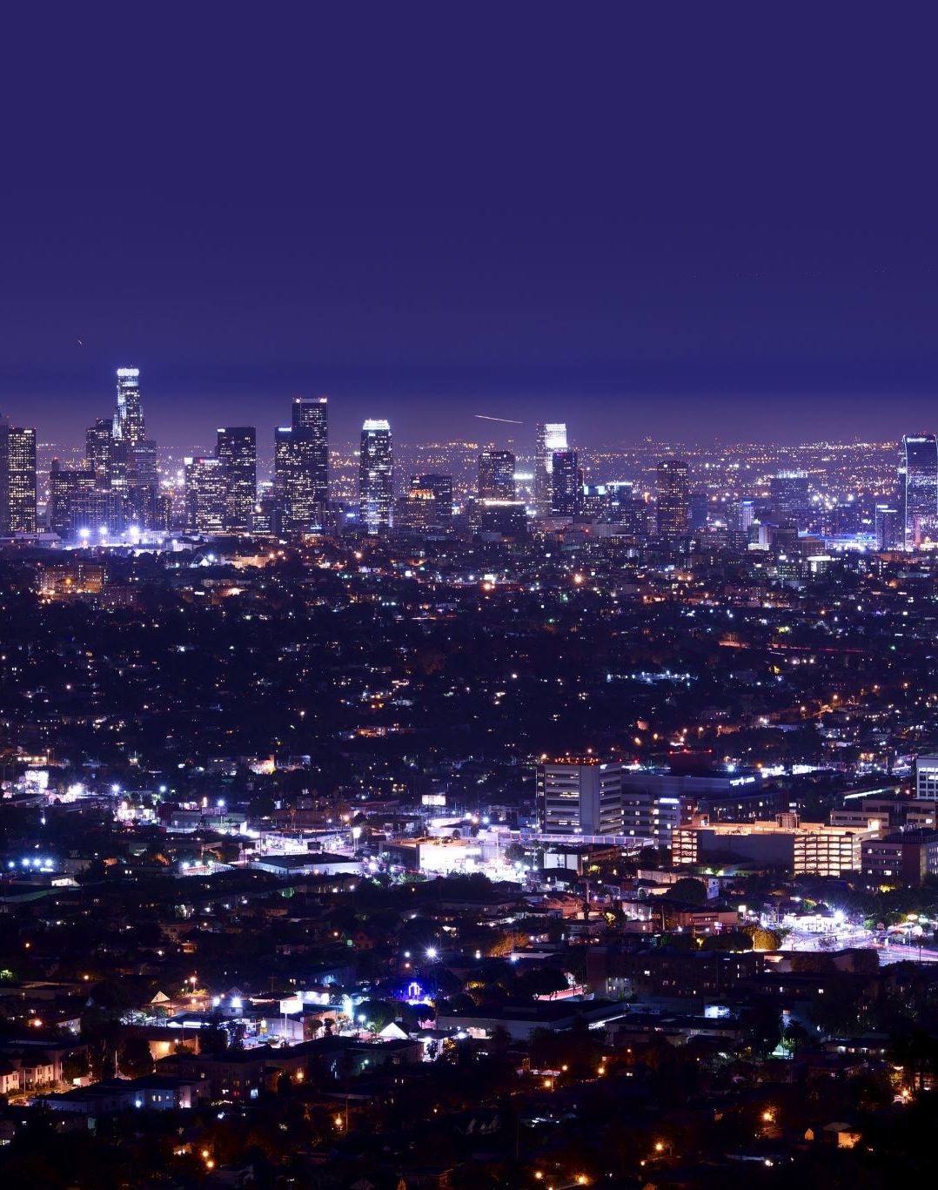
Motivation:
We chose this project to better understand real-world crime patterns in Los Angeles using publicly available LAPD data. With rising concerns around urban safety and access to large-scale data, we wanted to explore how data analytics and machine learning could help reveal when and where crimes happen most often. This project also gave us a chance to apply what we’ve learned in a meaningful, practical context—especially by working with real data.
Notes:
Added the Motivation that drive us to choose this project

Slide 5
Data Overview
Dataset Source:
Los Angeles Police Department (LAPD) – Public Crime Data Portal
Covers incidents reported from January 2020 to Feb 2025
Dataset Size and Scope:
Up to one million crime records across Los Angeles.
27 variables including time, location, victim demographics, and crime details.
Challenges Identified:
Missing or incorrect coordinates (e.g., 0°, 0°).
Variability in crime description categories.
Imbalanced crime type distribution across divisions.

Slide 6

Data Cleaning and Wrangling
Dropped rows with missing critical fields (LAT, LON, AREA NAME, DATE OCC, TIME OCC, Crm Cd Desc).
Removed invalid geographic coordinates (where LAT = 0 and LON = 0).
Converted DATE OCC into proper datetime format.
Extracted Hour from TIME OCC and Weekday from DATE OCC.
Selected key features: Hour, Weekday, Latitude, Longitude, Area Name.

Slide 7
RESEARCH QUESTIONS
Exploratory Data Analysis Questions
What kinds of crimes are most recorded in Los Angeles, and how have they evolved over time (monthly and annually)?
Which parts of Los Angeles have the highest crime rates, and what kinds of crimes are most prevalent there?
Advanced Analytics Machine Learning Questions
Is it possible to anticipate the sort of crime based on location (latitude, longitude, area name) and time (hour, weekday)?
To what extent can Los Angeles crime categories be predicted using classification methods such as logistic Regression?

Slide 8
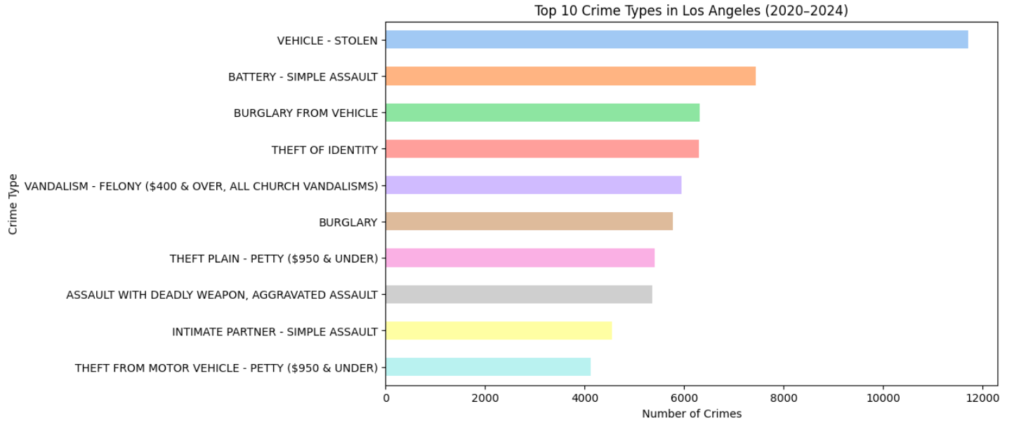
Research Questions
What types of crimes are most recorded, and how have they evolved monthly and annually?
The most frequently recorded crime types from 2020 to 2024 are:
Vehicle Theft (highest)
Battery - Simple Assault
Burglary from Vehicle.
Vehicle Theft is the single most common crime type over the years

Slide 9
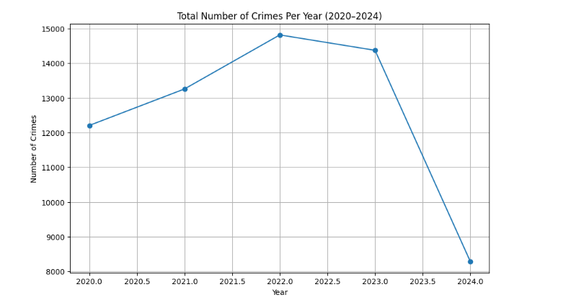
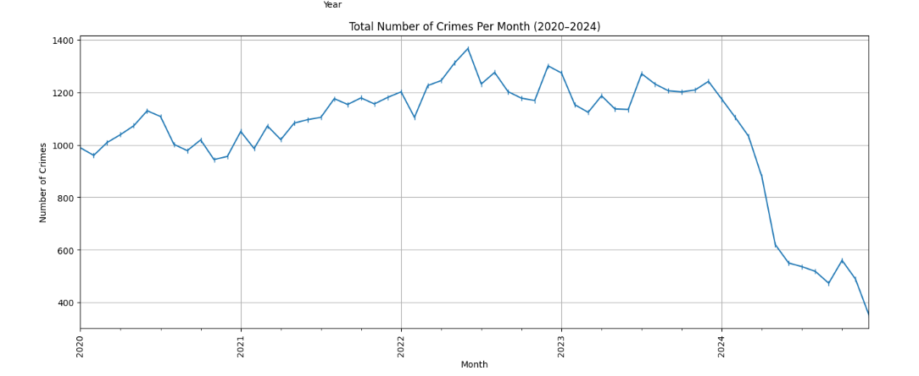
From the yearly crime trend chart, we observe: Crimes increased steadily from 2020 to 2022. Peak in 2022 – highest number of crimes recorded (~15,000 incidents). Slight decrease in 2023 — but still high. Sharp decline in 2024.
From the monthly crime trend chart:
Crimes gradually increased month by month from early 2020 to late 2022.
Minor fluctuations seen month-to-month, but general growth until early 2023.
Sharp decline in 2024 months, matching annual trend.
Notes:
As per the instructions from the professor we tried to modify the line graph but we found the reason that the significant drop in crime numbers for 2024 is likely due to incomplete or partially reported data for that year.

Slide 10
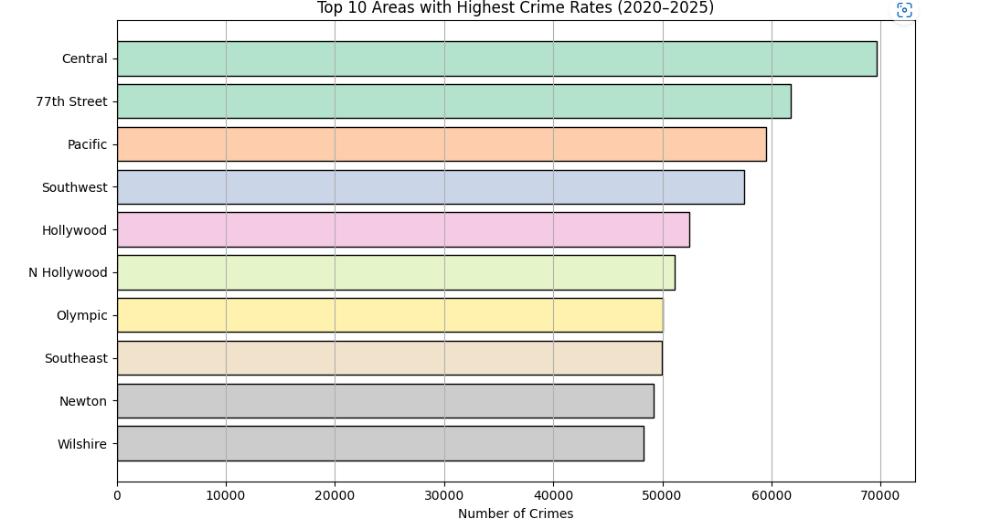
2. Which parts of Los Angeles have the highest crime rates, and what kinds of crimes are most prevalent there?
Based on crime volume from 2020–2025,
The Top 3 areas with the highest crime rates are:Central (most recorded crimes)77th Street and Pacific
Other major hotspots include Southwest, Hollywood, and North Hollywood

Slide 11
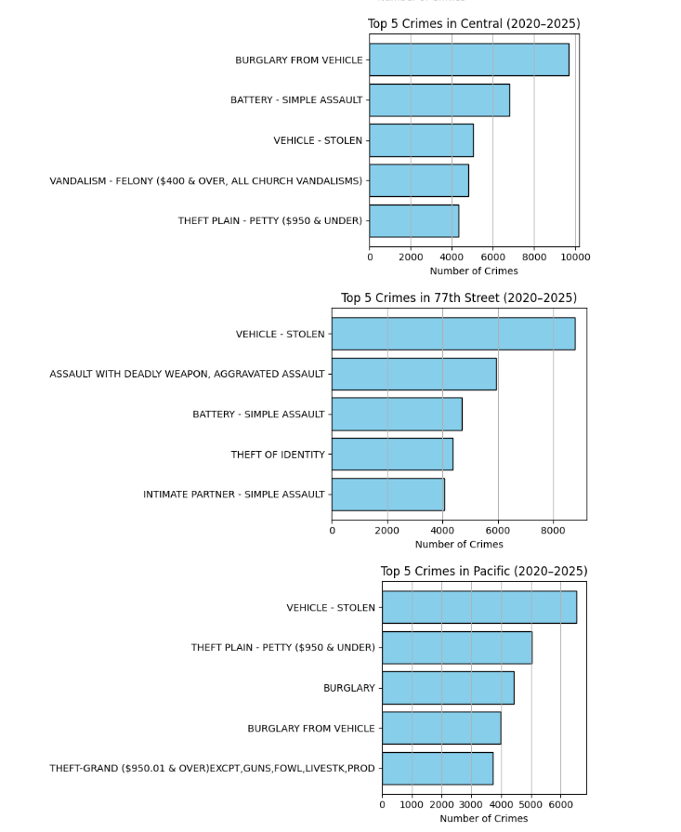
Most prevalent types of crimes in top 3 crime hotspots
Central - Dominated by burglary from vehicles and simple assaults.
77th Street - Vehicle theft is the most common crime, followed closely by aggravated assaults.
Pacific - Property crimes dominate, especially vehicle theft and petty theft.

Slide 12
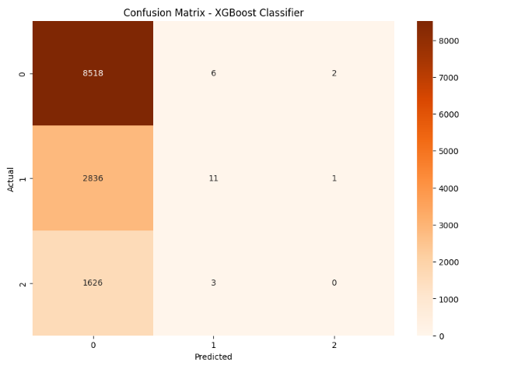
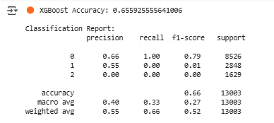
3. Is it possible to anticipate the sort of crime based on location and time ?
We used features like latitude, longitude, area name, hour, and weekday to predict the type of crime.
The XGBoost model achieved 66% accuracy, with high precision for the major crime class.
Confusion Matrix shows the model was highly accurate for Class 0, but struggled with minor classes (Class 1 & 2)

Slide 13
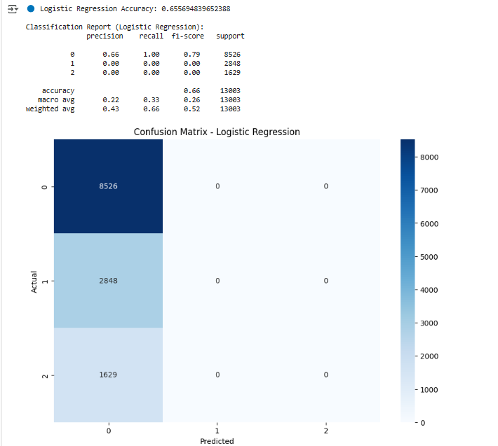
4. To what extent can Los Angeles crime categories be predicted using classification methods such as logistic Regression ?
Model Used: Logistic Regression
Overall Accuracy: 65.6%
Class 0 (Majority Crime Type): Good prediction (Precision 66%, Recall 100%)
Class 1 and 2 (Minority Crime Types): Very poor performance (Precision 0%, Recall 0%)
Model predicted only the majority crime type correctly
Failed to detect minority crime categories

Slide 14
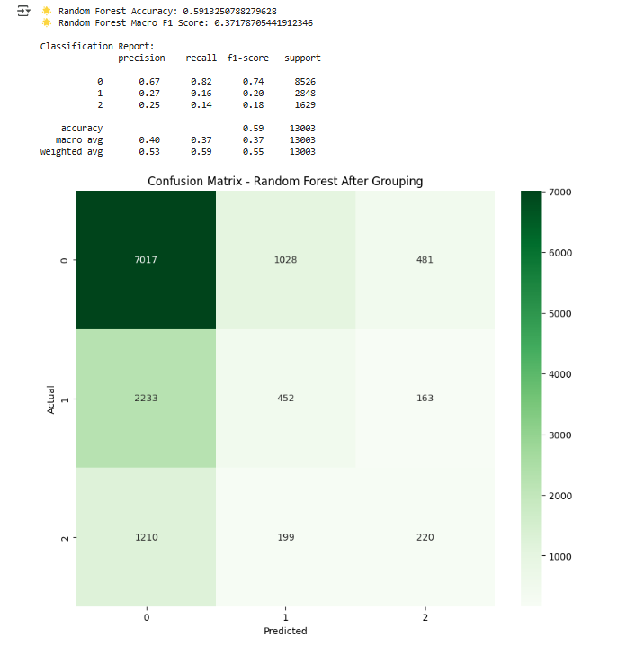
RANDOM FOREST MODEL
Accuracy: 59.13%
Macro F1-Score: 0.37
Weighted F1-Score: 0.55
Logistic Regression is simple but performs poorly for minority classes.
Random Forest offers better balance and captures complex crime patterns more reliably.
XGBoost achieves similar accuracy to Logistic Regression but slightly better handling of class imbalance
Random Forest had the best F1-Score, proving it was better at predicting all types of crimes fairly, not just the majority class.

Slide 15
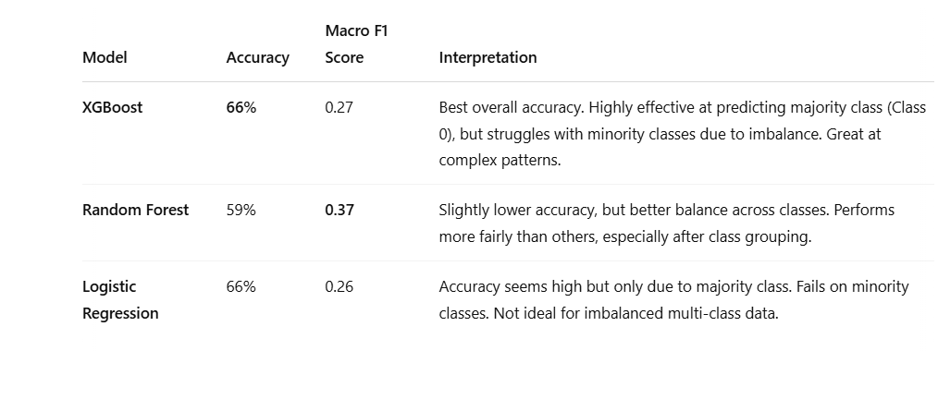
Model Comparision

Slide 16

Conclusions and Recommondations
Major crimes such as theft, assault, burglary are highly concentrated in specific hotspots and during particular times (evenings, weekends)
📍 Stay cautious in high-crime areas, especially during known high-risk times (evenings, weekends).
🛡️ Secure vehicles and belongings properly in public spaces.
📲 Use mobile apps that show real-time crime alerts based on location.
🧑‍🤝‍🧑 Participate in neighborhood watch programs and community safety efforts.

Slide 17

Thank you

Slide 18

Any Questions ?

